Slide 1

Covid-19 Presentation
Amish Ilyas

Slide 2



agenda
Introduction​
Dataset Overview
Analysis With SQL​
Insights

Slide 3


Introduction
COVID-19, also known as the coronavirus, is a highly contagious virus that first appeared in late 2019. It quickly spread worldwide, causing a global pandemic. The virus primarily spreads through respiratory droplets when an infected person coughs, sneezes, or talks. Symptoms can range from mild, such as a fever and cough, to severe, such as difficulty breathing. COVID-19 has had a significant impact on public health, economies, and daily life around the world.

Slide 4

DATASET OVERVIEW
Province: Geographic subdivision within a country/region. Country/Region: Geographic entity where data is recorded. Latitude: North-south position on Earth's surface.
Longitude: East-west position on Earth's surface.
Date: Recorded date of CORONA VIRUS data.
Confirmed: Number of diagnosed CORONA VIRUS cases. Deaths: Number of CORONA VIRUS related deaths. Recovered: Number of recovered CORONA VIRUS cases.

Slide 5
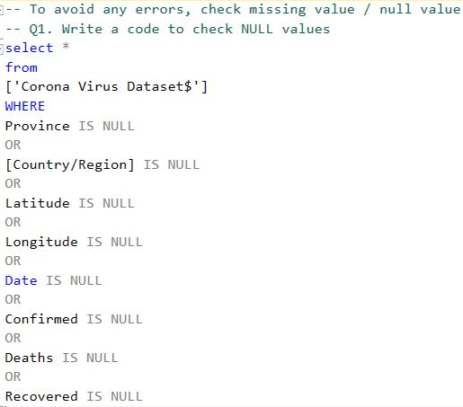
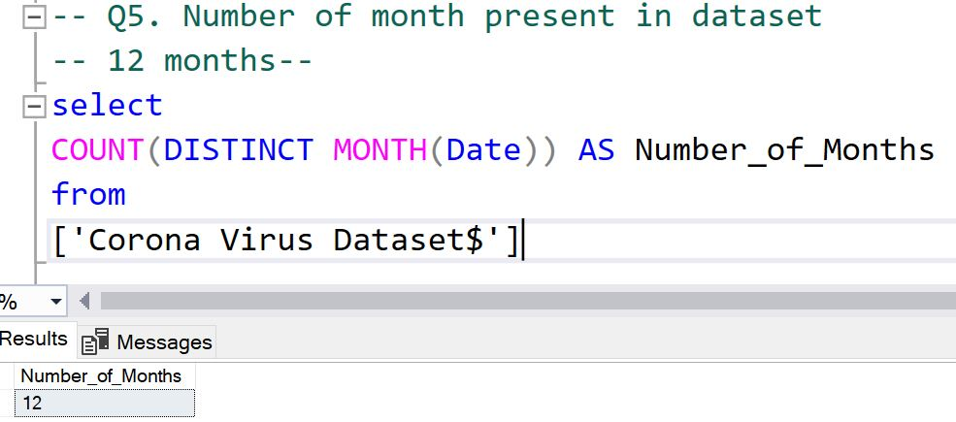
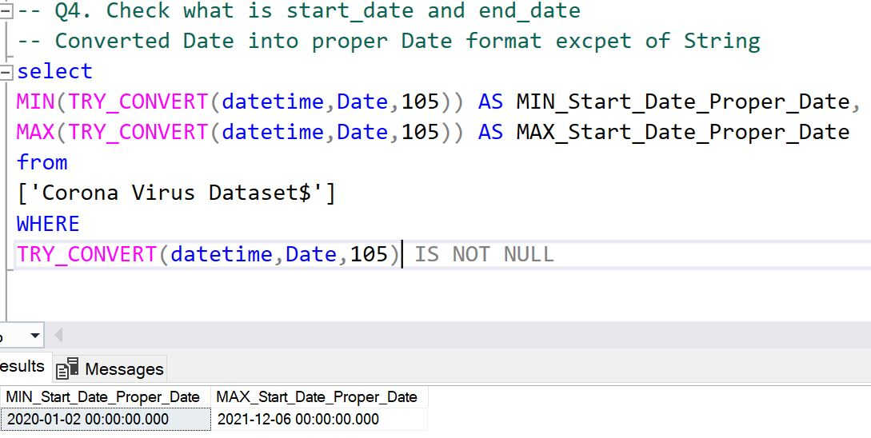
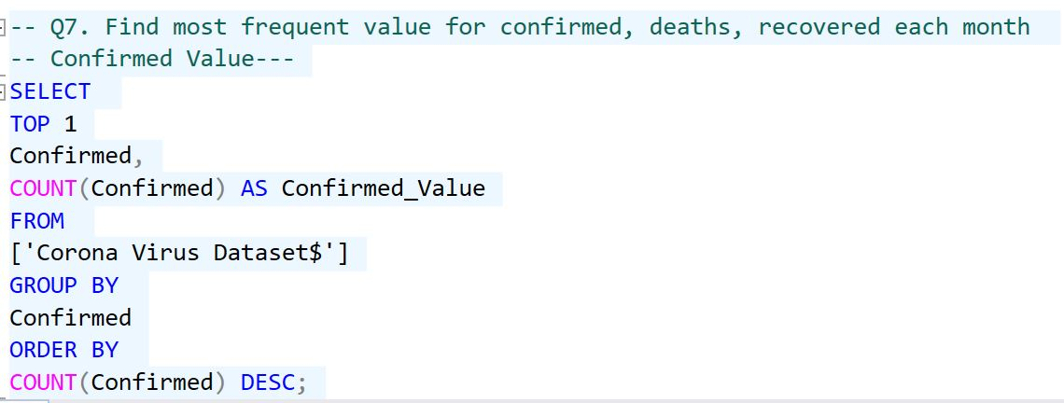
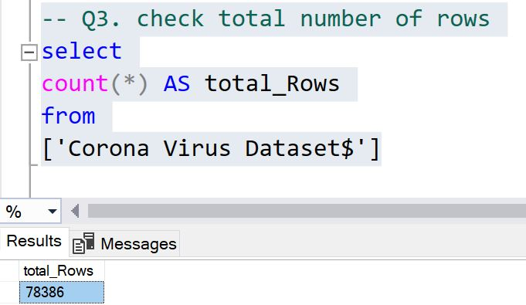
Analysis With sQl

Slide 6
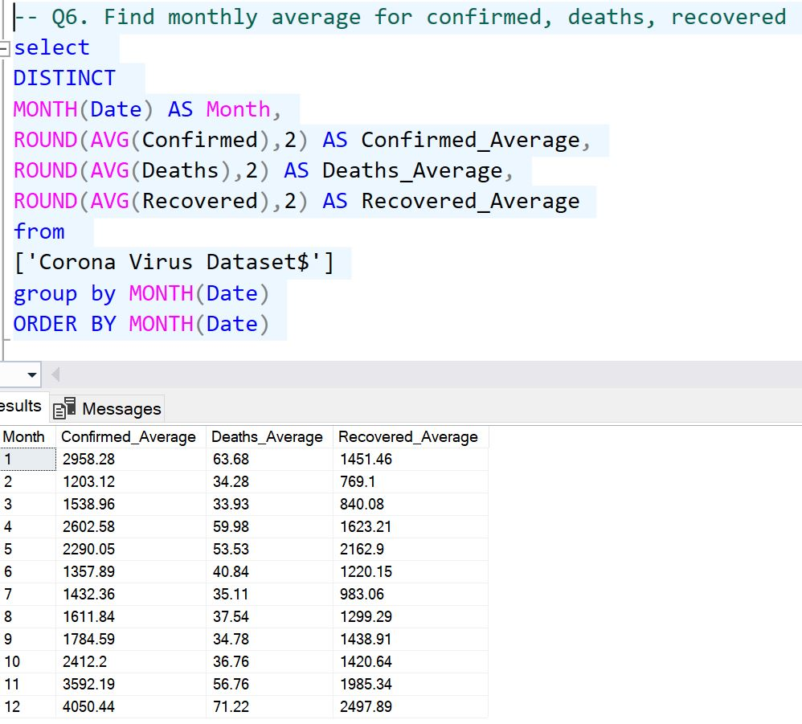
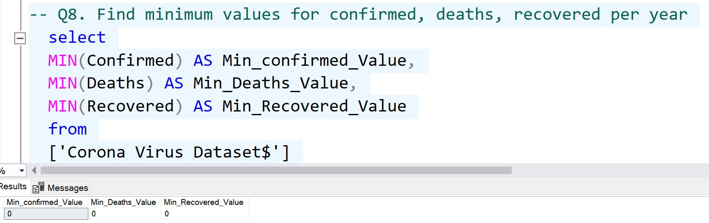
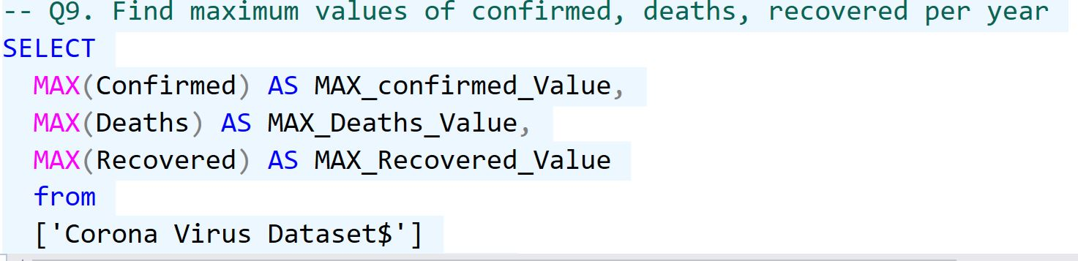
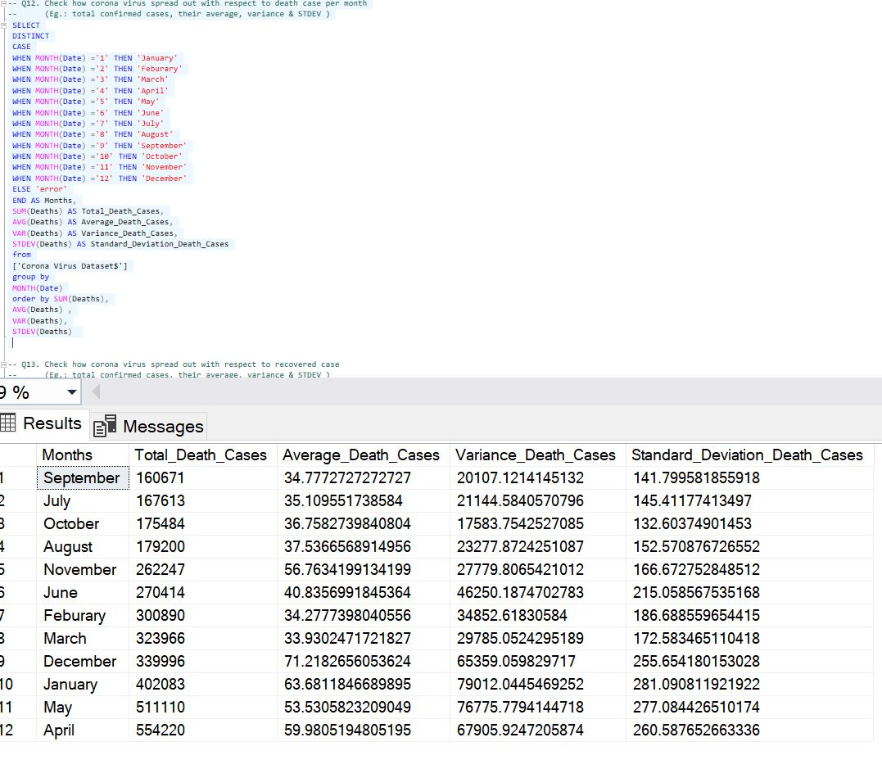
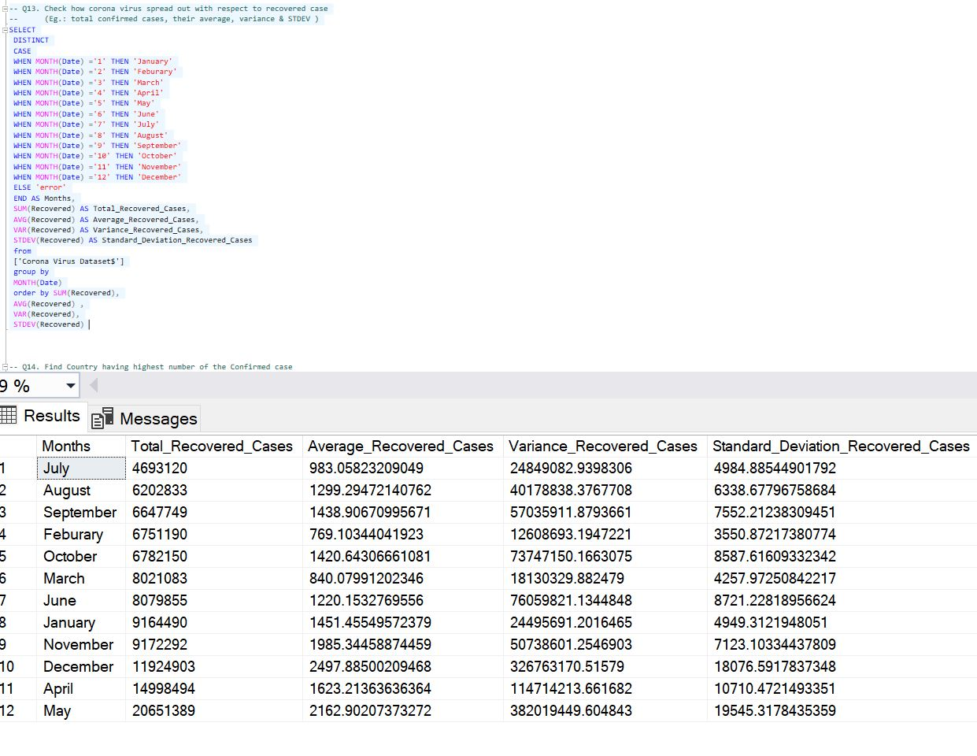
Analysis with sql

Slide 7

INSIGHTS
Total Records : 78386
Total Months : 12
Date : 2 Jan 2020 to 6 DEC 2021
Max Confirmed Cases 2021 : 414188
Max Deaths 2021 : 7374
Max Recovered 2021 : 422436
Max Confirmed Cases 2020 : 823225
Max Deaths 2020 : 3752
Max Recovered 2020 : 1123456

Slide 8
INSIGHTS
Total Confirmed Cases : 169065144
Total Deaths : 3647894
Total Recovered : 113089548
Least Confirmed Cases Were In : July August September
Most Confirmed Cases Were In : December May April
Least Deaths Were In : September July October
Most Deaths Were In : January May April
Least Recovery was In : July August Seotember
Most Recovery was In : December April May

Slide 9
INSIGHTS
Top 5 Countries With Most Cases :
US 33461982
India 29460523
Brazil 17412766
France 6105002
Turkey 5330447
Country With Lowest Cases :
Tibet 0

Slide 10
INSIGHTS
TOP 5 Countries With Highest Recovery
India 28089649
Brazil 15400169
US 6303715
Turkey 5202251
Russia 4745756

Slide 11

Thank you
Amish Ilyas
ilyasamish@gmail.com
+923346129654

